Slide 1

Big Data and Hadoop
Presented By:
Elizer Ponio Jr. Department of Computer Science
College of Computing and Information Technologies

Slide 2
Outline
Big Data
Hadoop
Hadoop Components

Slide 3
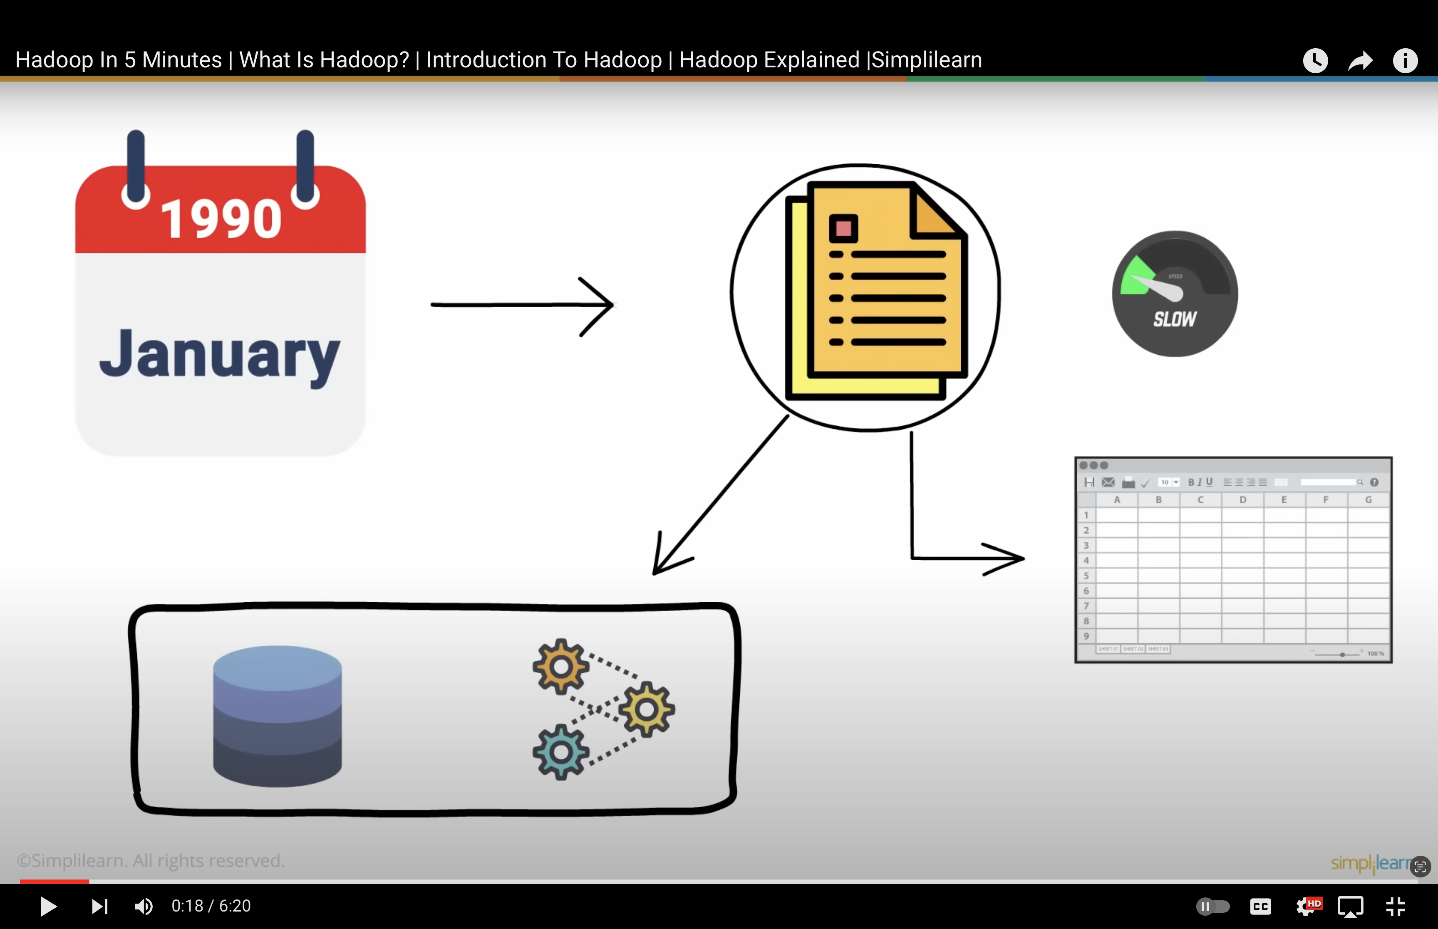

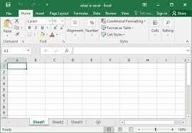




Notes:
Before the internet became popular and widely used, miniscule amounts of data were generated at a relatively sluggish pace.
All the data was mostly documents, storing and processing this data was not a problem as a single storage unit and processor combination would do the job

Slide 4

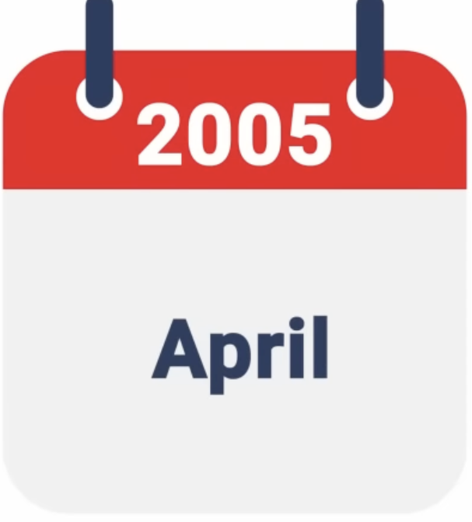




Notes:
But as the years passed by, the internet literally too, the world by storm, giving rise to tons of data generated in a multitude of forms and formats every microsecond

Slide 5





Big Data
Notes:
Semi structed and unstructured was available now in the form of emails, images, audio and video to name a few
All this data became collectively known as BIG DATA

Slide 6
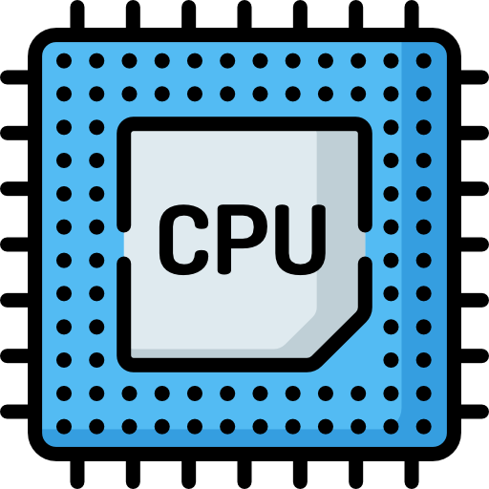



Notes:
Although fascinating, it became nearly impossible to handle this big data.
And a storage unit and processor combination was obviously not enough
So what was the solution?

Slide 7


Hadoop
Notes:
Multiple storage units and processors were undoubtedly the need of the hour.
This concept was incorporated in the framework of Hadoop that could store and process vast amounts of any data efficiently using a cluster of commodity hardware
Hadoop is a framework that manages big data storage in a distributed way and processes it parallelly

Slide 8



Components of Hadoop
Hadoop consisted of three components that were specifically designed to work on big data.

Slide 9
Hadoop - Storage Unit
The first component of Hadoop is its Storage Unit, called the Hadoop Distributed File System or (HDFS).
Notes:
In order to capitalize on data, the first step is storing it
The first component of Hadoop is its storage unit, The Hadoop distributed file system

Slide 10

Hadoop - Storage Unit
Data is stored in many computers and is stored in blocks
Notes:
Storing massive amount of data is unfeasible, hence the data is distributed amongst many computers and stored in blocks

Slide 11

Hadoop - Storage Unit
600 mb
Block A
Block B
Block C
Block D
Block E
128 mb
128 mb
128 mb
128 mb
88 mb
Notes:
So if you have 600 megabytes of data to be stored, HDFS splits data into multiple blocks of data that are then stored on several data nodes in the cluster
128 megabytes is the default size of each block, hence 600 megabytes will be split into four blocks, A, B, C, D of 128 megabytes each.
And The remaining 88 megabytes in the last block E

Slide 12
Hadoop - Storage Unit
600 mb
Block A
Block B
Block C
Block D
Block E
128 mb
128 mb
128 mb
128 mb
88 mb
Replication Method
Data is not lost at any cost even if one DataNode crashes, making HDFS fault tolerant
Block A
Block A
HDFS makes copies of the data and stores it across multiple systems
Notes:
So you might be wondering, what if one data node crashes? Do we lose that specific data? Well no!
The strength of HDFS is that it makes copies of the data and stores it across multiple systems.
For example, when block A is created, it is replicated with a replication factor of 3 and stored on different data nodes. This is termed the replication method
By doing so, data is not lost at any cost even if one data node crashes making HDFS fault-tolerant.

Slide 13
Map Reduce
Notes:
After storing the data successfully, it needs to be processed
This is where the second component of Hadoop comes in, MAP REDUCE

Slide 14

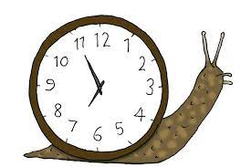


Hadoop – Map Reduce
Traditional processing method
Final output
Processing large volumes of a variety of data
Notes:
In the traditional data processing method, entire data would be processed on a single machine having a single processor.
This consumed time and was inefficient, especillay when processing large volumes of a variety of data.
To overcome this, mapreduce splits data into parts and processes each of them separately on different data nodes.
The individual results are then aggregated to give the final output.

Slide 15
Input
Split
Mapper Phase
Shuffle and Sort
Reduce Phase
one
One a penny
one, 1
a, 1
penny, 1
a
a
a, 2
buns, 1
cross, 1
hot, 1
one, 1
penny, 2
two, 1
One a penny, two a penny, hot cross buns
penny
penny
two a penny
two, 1
a, 1
penny, 1
two
hot
hot cross buns
hot, 1
cross, 1
buns, 1
cross
buns
Notes:
Lets try to count the number of occurrences of words taking this example,
First, the input is split into 5 separate parts based on full stops
The next step is the mapper phase, where the occurrence of each word is counted and allocated a number
After that, depending on the words, similar words are shuffled, sorted and grouped together.
Next, in the reducer phase, all the grouped words are given a count
Finally the output is displayed by aggregating the results.

Slide 16



Hadoop – Map Reduce
Input
Split
Mapper Phase
Shuffle and Sort
Reduce Phase
one
One a penny
one, 1
a, 1
penny, 1
a
a
a, 2
buns, 1
cross, 1
hot, 1
one, 1
penny, 2
two, 1
One a penny, two a penny, hot cross buns
penny
penny
two a penny
two, 1
a, 1
penny, 1
two
hot
hot cross buns
hot, 1
cross, 1
buns, 1
cross
buns
Notes:
All this is done by writing a simple computer program
Similarly, map reduce processes each part of big data individually and then sums the result and the end.
This improves load balancing and saves a considerable amount of time.

Slide 17


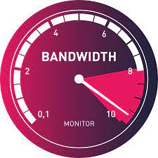
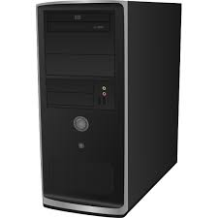

YARN
Notes:
Now that we have our map reduce job ready, it is time for us to run it on the Hadoop cluster
This is done with the help of a set of resources such as RAM, network bandwidth and CPU
Multiple jobs are run on Hadoop simultaneously and each of them needs some resources to complete the task successfully
To efficiently manage these resources, we have the 3rd component of Hadoop which is YARN

Slide 18




YARN
Resource Manager
Container
Node Manager
Application Master
Notes:
YARN is a resource negotiator that consists of a
Resource manager
Node manager
Application master
Containers
The resource manager assigns resources,
node managers handle the nodes and monitors the resource usage in the node,
The containers hold a collection of physical resources.

Slide 19
YARN
Resource Manager
Node Manager
Application Master
Notes:
Suppose we want to process the mapreduce job we had created
First, the application master requests the container from the node manager
Once the node manager gets the resources, it sends them to the resource manager.
This way, yarn processes job requests and manages cluster resources in hadoop

Slide 20





Other Hadoop Components
Hadoop also has various big data tools and frameworks dedicated to managing, processing and analyzing data
Notes:
In addition to these components ( Storage, MAPREDUCE, YARN),
Hadoop also has various big data tools and frameworks dedicated to managing , processing and analyzing data
The Hadoop ecoysystem comprises several other components like hive, pig, spark, flume and scoop.

Slide 21





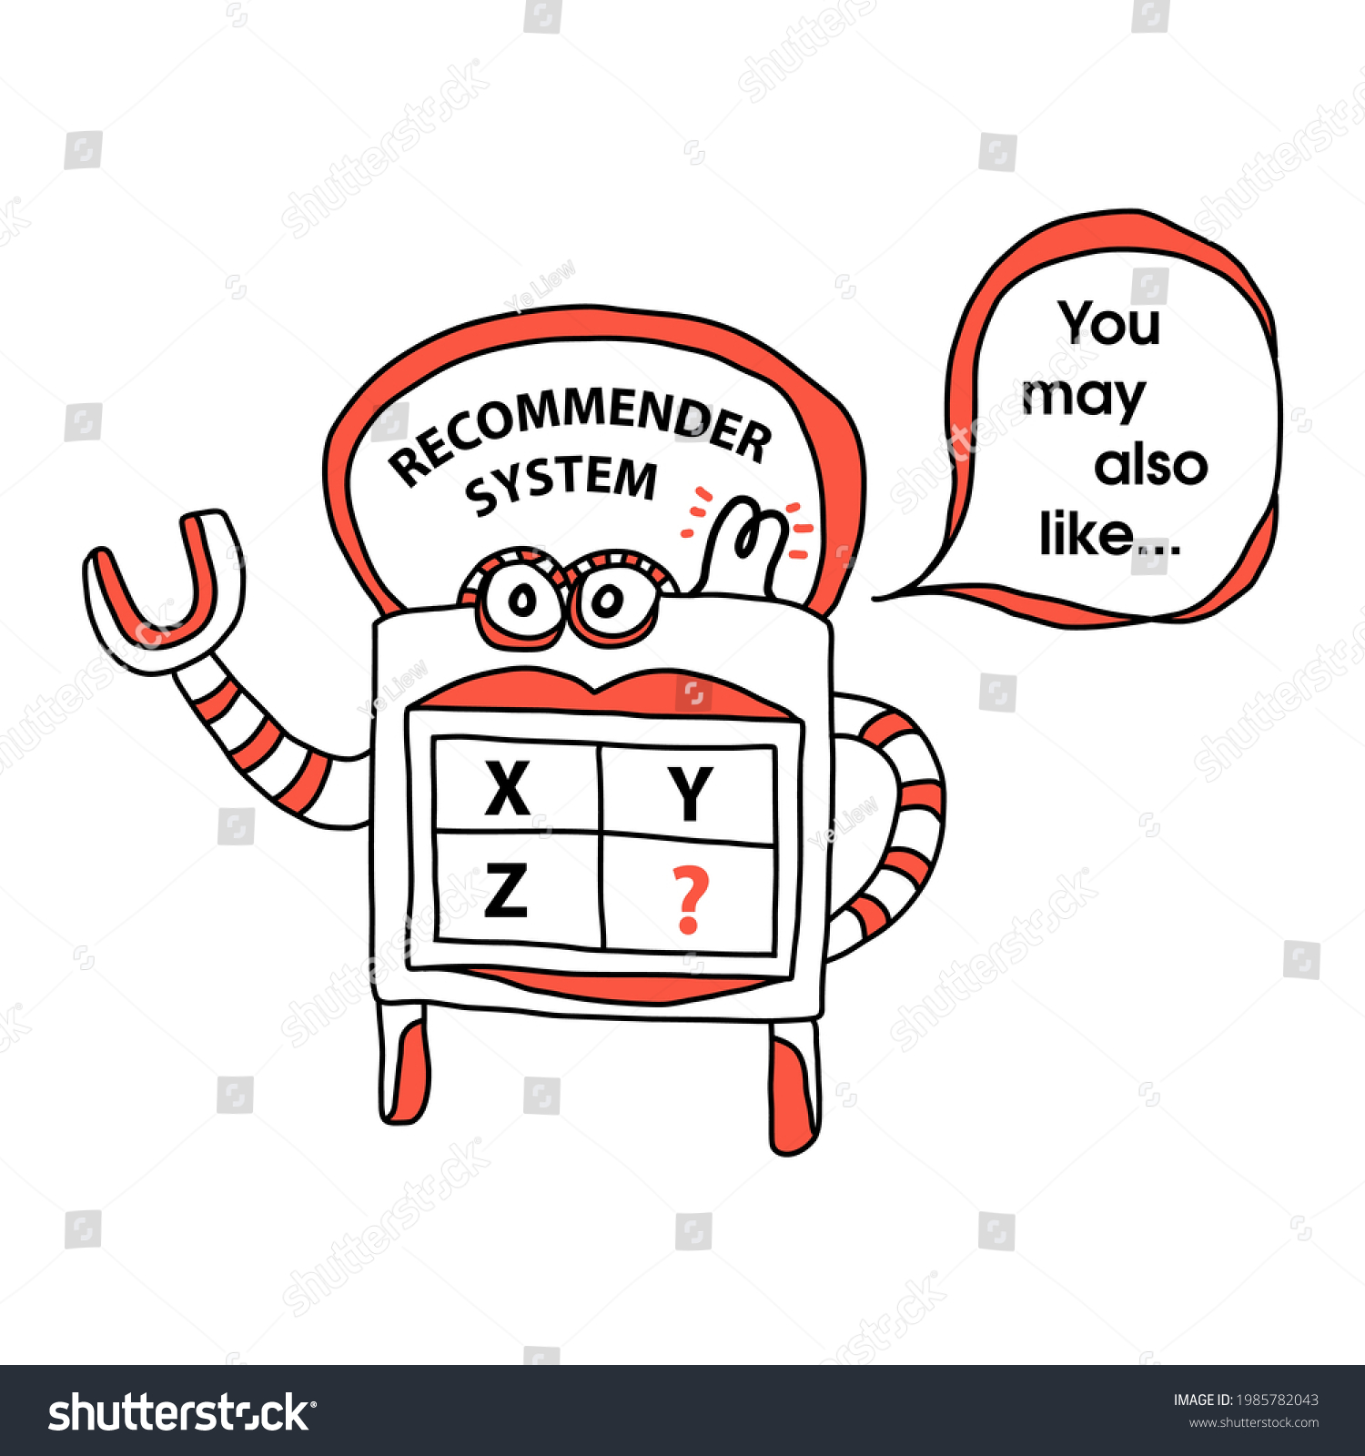

Hadoop for Businesses
These companies use Hadoop for several applications such as:
Notes:
There are several applications of Hadoop like
data warehousing
Recommendation systems
Fraud detection.

